Slide 1
17. Upright men can even better convince themselves of the solid grounds on which the teaching of the Church in this field is based, if they care to reflect upon the consequences of methods of artificial birth control. Let them consider, first of all, how wide and easy a road would thus be opened up towards conjugal infidelity and the general lowering of morality.

Slide 2
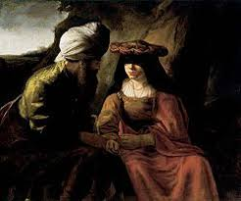
The Sin of Onan. Genesis: 38

Slide 3
The consistent teaching of the Church against any forms of ‘contraception, from the earliest times, through the Fathers, the penitential practices and decrees, moral manuals.
And still consistently taught by all Christians, even after the ‘Reformation’…
That is, until…

Slide 4
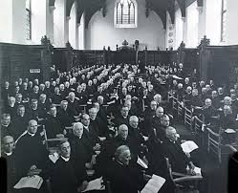
Seventh Lambeth Conference, July 7-12, 1930

Slide 5
Resolution 15 allowed "in those cases where there is such a clearly felt moral obligation to limit or avoid parenthood, and where there is a morally sound reason for avoiding complete abstinence, the Conference agrees that other methods may be used, provided that this is done in the light of the same Christian principles."

Slide 6
The vote for this Resolution was 193 for it, 67 against it, and 47 not voting. (This was the only Resolution for which a record of the numbers voting was required)

Slide 7
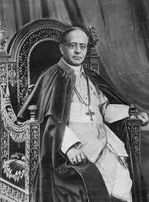
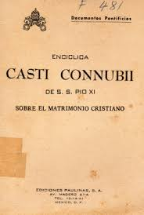
Since, therefore, the conjugal act is destined primarily by nature for the begetting of children, those who in exercising it deliberately frustrate its natural power and purpose sin against nature and commit a deed which is shameful and intrinsically vicious
Casti Connubii, Pius XI, Dec. 31, 1930

Slide 8
Since, therefore, the conjugal act is destined primarily by nature for the begetting of children, those who in exercising it deliberately frustrate its natural power and purpose sin against nature and commit a deed which is shameful and intrinsically vicious
Casti Connubii, Pius XI, Dec. 31, 1930

Slide 9
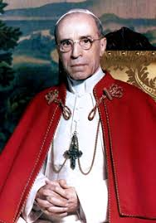
Virtuous ‘periodic continence’ to avoid children
a.k.a., the ‘rhythm method’

Slide 10
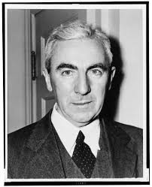
Dr. John Rock (Harvard) 1890-1984

Slide 12
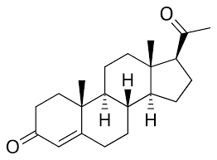
Progesterone (endogenous)

Slide 13
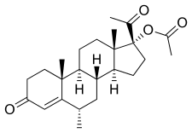
Progestin (exogenous)

Slide 14
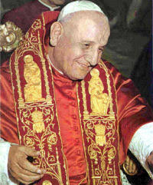
Pope Saint John XXIII (1958-1963)

Slide 15
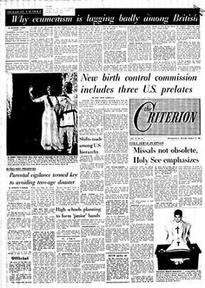
The ‘Birth Control Commission’, 1963

Slide 16
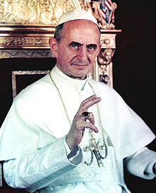
Pope Saint Paul VI (1963-1978)
Continued the ‘Commission’, increased members to 73

Slide 17
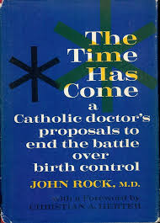
1964

Slide 18
The ‘Comstock’ Laws, passed March 3, 1873, were a series of federal statutes forbidding the use of the U.S. Postal Service to send any ‘obscenity, contraceptives, abortifacients, sex toys, any personal letters with sexually explicit content, or any information regarding the above

Slide 19
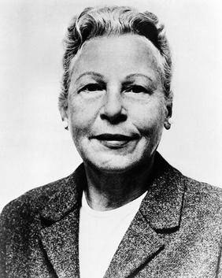
Laws were soon extended state by state to forbid the use of contraceptives, and Connecticut was one of them.
Estelle Griswold was the Executive Director of the Planned Parenthood League of Connecticut, and brought the state’s proscription of contraceptives to the Supreme Court in 1965
Wikipedia.org

Slide 20
The Supreme Court handed down its infamous Griswold vs. Connecticut on June 7, 1965 in a 7 – 2 decision, striking down the law against contraceptives, which thus became the law of the land.
Pornography and abortion were soon to follow.

Slide 21
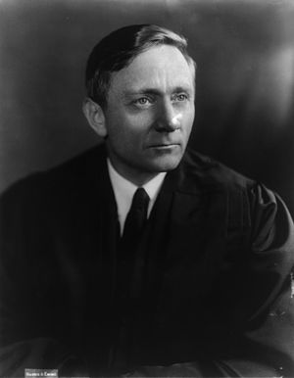
Would we allow the police to search the sacred precincts of marital bedrooms for telltale signs of the use of contraceptives? The very idea is repulsive to the notions of privacy surrounding the marriage relationship.
Justice William O. Douglas

Slide 22
The ‘Majority Report’(approved overwhelmingly, only four against) leaked to the press, published in the Tablet and the National Catholic Reporter, 1967.
Approved by 64 of 69 votes. :{

Slide 23
The Majority Report Arguments:
Principle of Totality
Physicalism
Double Effect

Slide 24
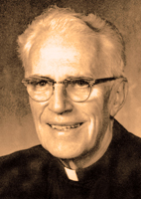
From the ‘Minority Report’:
If it should be declared that contraception is not evil in itself, then we should have to concede frankly that the Holy Spirit had been on the side of the Protestant churches in 1930. It should likewise have to be admitted that for a half a century the Spirit failed to protect Pius XI, Pius XII, and a large part of the Catholic hierarchy from a very serious error.

Slide 25
This would mean that the leaders of the Church, acting with extreme imprudence, had condemned thousands of innocent human acts, forbidding, under pain of eternal damnation, a practice which would now be sanctioned. The fact can neither be denied nor ignored that these same acts would now be declared licit on the grounds of principles cited by the Protestants, which Popes and Bishops have either condemned, or at least not approved.

Slide 26
July 25, 1968

Slide 27
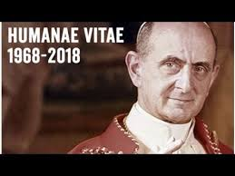
The conclusions at which the commission arrived could not, nevertheless, be considered by us as definitive, nor dispense us from a personal examination of this serious question; and this also because, within the commission itself, no full concordance of judgments concerning the moral norms to be proposed had been reached, and above all because certain criteria of solutions had emerged which departed from the moral teaching on marriage proposed with constant firmness by the teaching authority of the Church

Slide 28
Human married love is:
Human
Total
Faithful
Fecund

Slide 29
…the Church, calling men back to the observance of the norms of the natural law, as interpreted by their constant doctrine, teaches that each and every marriage act (quilibet matrimonii usus) must remain open to the transmission of life (ad vitam humanam procreandam per se destinatus permaneat )

Slide 30
The two ‘ends of the marital act:
Procreative
Unitive

Slide 31
These ends, procreative and unitive are joined by a nexu indissolubili

Slide 32
By safeguarding both these essential aspects, the unitive and the procreative, the conjugal act preserves in its fullness the sense of true mutual love and its ordination towards man's most high calling to parenthood.
(Humanae Vitae, #12)

Slide 33
Not much experience is needed in order to know human weakness, and to understand that men—especially the young, who are so vulnerable on this point—have need of encouragement to be faithful to the moral law, so that they must not be offered some easy means of eluding its observance. It is also to be feared that the man, growing used to the employment of anti-conceptive practices, may finally lose respect for the woman and, no longer caring for her physical and psychological equilibrium, may come to the point of considering her as a mere instrument of selfish enjoyment, and no longer as his respected and beloved companion

Slide 34
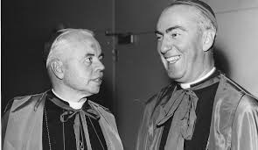
Archbishop Philip Pocock, left, and Bishop Gerald Emmett Carter, two of the key figures in drafting the Winnipeg Statement.

Slide 35
26. Counsellors may meet others who, accepting the teaching of the Holy Father, find that because of particular circumstances they are involved in what seems to them a clear conflict of duties, e.g., the reconciling of conjugal love and responsible parenthood with the education of children already born or with the health of the mother. In accord with the accepted principles of moral theology, if these persons have tried sincerely but without success to pursue a line of conduct in keeping with the given directives, they may be safely assured that, whoever honestly chooses that course which seems right to him does so in good conscience.

Slide 36
Declaration on Conscience (Dec. 1, 1973)
Liberating Potential (September 26, 2008)

Slide 37
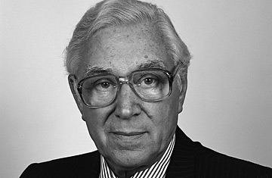
Dr. Patrick Steptoe (+1988)
Founder of IVF

Slide 38
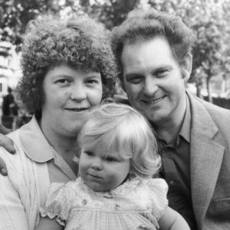
Louise Brown, July 25, 1968

Slide 39
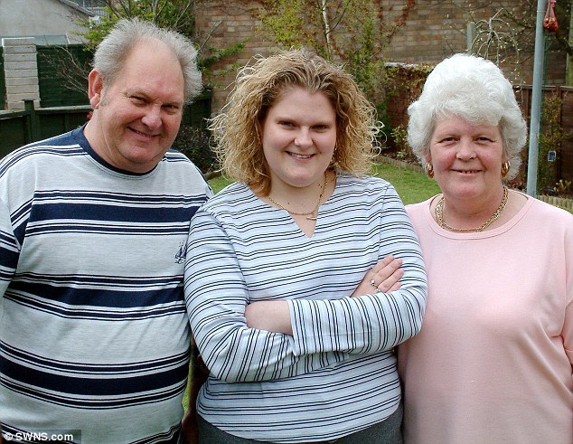

Slide 40
Let it be considered also that a dangerous weapon would thus be placed in the hands of those public authorities who take no heed of moral exigencies. Who could blame a government for applying to the solution of the problems of the community those means acknowledged to be licit for married couples in the solution of a family problem?

Slide 41
2267. Recourse to the death penalty on the part of legitimate authority, following a fair trial, was long considered an appropriate response to the gravity of certain crimes and an acceptable, albeit extreme, means of safeguarding the common good.
Today, however, there is an increasing awareness that the dignity of the person is not lost even after the commission of very serious crimes. [1] FRANCIS, Address to Participants in the Meeting organized by the Pontifical Council for the Promotion of the New Evangelization, 11 October 2017: L’Osservatore Romano, 13 October 2017.

Slide 42
In addition, a new understanding has emerged of the significance of penal sanctions imposed by the state. Lastly, more effective systems of detention have been developed, which ensure the due protection of citizens but, at the same time, do not definitively deprive the guilty of the possibility of redemption.
Consequently, the Church teaches, in the light of the Gospel, that “the death penalty is inadmissible because it is an attack on the inviolability and dignity of the person”,^{[1]} and she works with determination for its abolition worldwide”.

Slide 43
Demographers tell us that a society must have a “Total Fertility Rate” (TFR) of slightly over 2.1 (the average number of children a woman has during her child-bearing years) in order to maintain its population over time. well below population-replacement level and heading toward the demographic Niagara Falls that demographers call “lowest-low fertility.”

Slide 44
China’s One Child Policy
Instituted 1979, after a decade long two child policy
Now, back to two child, but too little, too late

Slide 45
Here are the most recent Eurostat TFP figures for the countries of the European Union in 2014:
Austria: 1.47;
Belgium: 1.74;
Bulgaria: 1.53;
Croatia: 1.46;
Cyprus: 1.31;
Czech Republic: 1.53;
Denmark: 1.69;
Finland: 1.71;
France: 2.01;
Germany: 1.47;
Great Britain: 1.81;

Slide 46
Greece: 1.30;
Hungary: 1.44;
Ireland: 1.94;
Italy: 1.37;
Latvia: 1.54;
Lithuania: 1.63;
Luxembourg: 1.50;
Malta: 1.42;
Netherlands: 1.71;

Slide 47
Poland: 1.32;
Portugal: 1.23;
Romania: 1.52;
Spain: 1.32;
Slovakia: 1.37;
Slovenia: 1.58;
Sweden: 1.88.

Slide 48
Niger: 6.49
Angola: 6.16
Mali: 6.01
Burundi: 5.99
Somalia: 5.8
Burkina Faso: 5.71
Uganda: 5.71

Slide 49
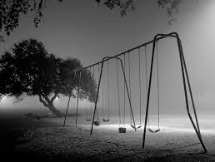
Thus, the TFR for the European Union as a whole in 2014 was 1.58

Slide 50
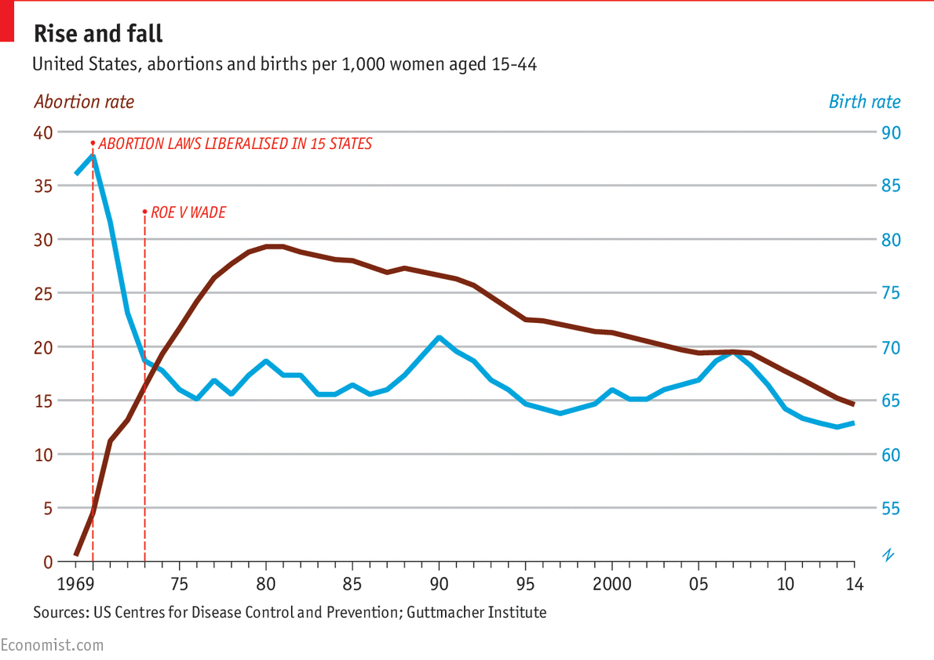

Slide 51
Just 8 percent (of Catholics) said contraception is morally wrong, with 89 percent saying it was either morally acceptable or not a moral issue at all.
https://www.americamagazine.org/faith/2016/09/28/poll-finds-many-us-catholics-breaking-church-over-contraception-abortion-and-lgbt
http://www.pewforum.org/2016/09/28/where-the-public-stands-on-religious-liberty-vs-nondiscrimination/

Slide 52
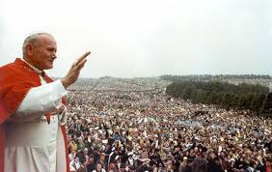
‘Theology of the Body’
129 Wednesday Audiences between
1979-1984

Slide 53
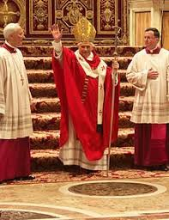
Deus Caritas Est (December 25, 2005)
The Christian fusion of ‘eros’ and ‘agape’, misunderstood and separated in the ancient world.
Analogy to the unitive and procreative dimensions

Slide 54
Spe Salvi (November 30, 2007)
In what do we hope?

Slide 55
The problem is not just a moral one, or a sin of the passions, (even if it may have begun as such) a form of acratia.
There is something deeper at work, a metaphysical malaise, a desire not to live, nor to hand on life, a deep-rooted and subtle despair.

Slide 56
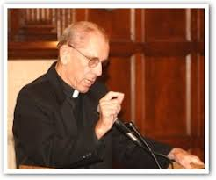
The most difficult thing to confront about the tradition of Humanae Vitae, then, is its position that the issue lies at the point of contraception, not abortion, social structure, euthanasia, or homosexuality. All of these somehow follow from the first with a logic that is awesome…
Father James V. Schall, S.J.
Christianity and Life (Ignatius Press, 1981)

Slide 57
It is symbolically and directly connected with the inner nature of God and with the peculiar kind of metaphysics that flows from Christianity, that which conceives “being” as primarily a gift from God.
Father James V. Schall, S.J.
Christianity and Life (Ignatius Press, 1981)

Slide 58
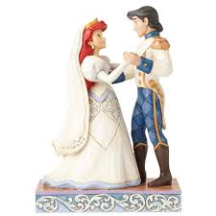
Despair:
To lose hope in the right thing.
Or to hope in the wrong thing.
Or hope too much in the right thing.

Slide 59
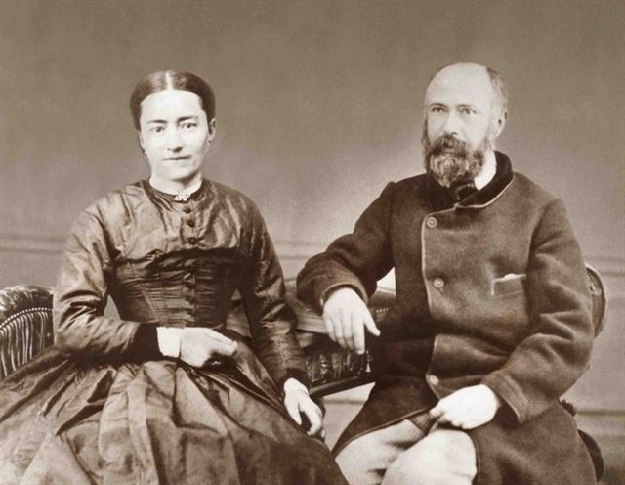
Reason
Will
Emotion
Sense or Sensibility?

Slide 60
The teaching of the Church on the regulation of birth, which promulgates the divine law, will easily appear to many to be difficult or even impossible of actuation. And indeed, like all great beneficent realities, it demands serious engagement and much effort, individual, family and social effort. More than that, it would not be practicable without the help of God (gratia Dei), who upholds and strengthens the good will of men

Slide 61
